Slide 1
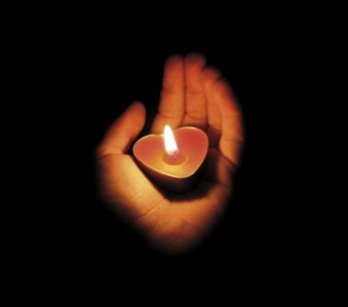
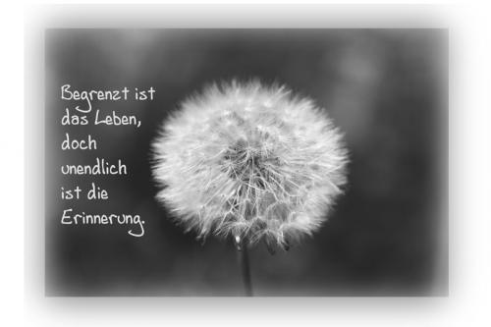
Silent Keys 2023
HB3YSX | Müri Walter-Albert |  | HB9JBO | Fleischmann Walter
HB3YWY | Kutz Ulrich |  | HB9KAZ | Rossi Agostino
HB9AGU | Uhlmann Gilbert |  | HB9LBD | Rüdisühli Walter
HB9AKN | Tobler Werner |  | HB9NAE | Abt Karl
HB9AQS | Zimmermann Hans |  | HB9NW | Ryter Renato
HB9ATW | Ringele Werner |  | HB9OCV | Boni Daniele
HB9AYQ | Glutz Rudolf |  | HB9PHJ | Eugster Hanspeter
HB9BBZ | Tobler Viktor |  | HB9PRU | Bantle Christian
HB9BDM | Gerber Christian |  | HB9PVC | Schnegg Kurt
HB9BEF | Züllig Wilfried |  | HB9PVX | Burch Felix
HB9BSR | Schlaubitz Albert |  | HB9RAK | Bär René
HB9BTQ | Arpagaus Josef |  | HB9RAL | Brogle Alfred
HB9BVW | Limacher Franz |  | HB9SV | Ravarelli Enrico
HB9BZG | Zürcher Kurt |  | HB9TNY | Niggli Ulrich
HB9CIS | Lorch Hermann |  | HB9TWR | Emery Michel
HB9CIU | Seiler Andreas |  | HB9ZCE | Riesen Werner
HB9CJK | Derrer Heinz |  | HB9ZY | Stalder Gody
HB9CTS | Suter Peter |  | HE9AMT | Hammer Markus
HB9CXK | Eberli Egon |  | HE9JAT | Gretener Adolf
HB9DMR | Straub Hansulrich |  | HE9KFW | Steiner Paul
HB9EAF | Hoffmann Hans-Peter |  | HE9STR | Haller Thomas

